Slide 1
Summer Camp at Merryhill Elementary Summerlin
Your Mission:
Field Trips & Events
Arts, Music, Dance & Drama
Nature & Science
Sports & Games
2160 Snow Trail Las Vegas 89134 702-242-8838

Slide 2
Your Mission
Should you choose to accept it…
About our Camp
Each week, children ages 5-12 jump into action, participating in exciting sports programs, exploring nature, becoming involved in performing and creative arts, playing a part in group activities, and attending special events.
Our campers expand their horizons, embark on new adventures, and most importantly have fun. Our exceptional program and dedicated staff create an environment that forges lifelong friendships among our campers. We create a summer experience that is unforgettable!
Our camp features a unique selection of indoor and outdoor activities and field trips that take advantage of resources in the local area.
Our specialty camps are optional programs, operating during regular camp hours, which provide even more choices for unique and exciting adventures.
Hours
Monday-Friday 9:00am – 3:00 pm
Extended Care 7:00 am - 6:00 pm
Schedule (no camp July 4)
Week 1 June 12-16
Week 2 June 19-23
Week 3 June 26-30
Week 4 July 3-7
Week 5 July 10-14
Week 6 July 17-21
Week 7 July 24-28
Week 8 July 31-Aug. 4
Week 9 Aug.7-11
Special Features
Quality staff
Flexible, extended hours
Field trips, special events
Air conditioned facility/bus
Lunch program
Family activities
New This Year!
Coming Soon!
Merryhill Elementary Summer Camp 2017

Slide 3
Activity Blocks
Gadgets, Gizmos & Gears Challenging and fun projects encourage collaboration, decision making, and innovation. Students work together to solve problems, while developing a love of math and science.
Art Frenzy
From painting, to sculpting, to drawing and more, campers are empowered to express their inner artist and let their imaginations soar.
Mission Possible
Children learn about how they can be heroes in their communities, and find creative ways to give back to those in need.
Excursion Unknown
Get your passport ready! Children fearlessly navigate their way through different traditions, games, and cultures from countries around the world.
Film/Photography
Campers explore the tools necessary to capture great images and videos, and refine them through digital imaging.
Science Solvers
Using extraordinary investigative skills, campers develop hypotheses and conclusions during fun science projects and experiments.
Block Party
Dream it. Build it. Wreck it. Repeat! Campers build elaborate objects, structures and vehicles, while exploring fundamental principles of engineering and physics.
Campers Got Talent
Jump roping? Hula-hooping? Let your hidden talents shine! Campers develop creativity and confidence through singing, dancing, acting and more.
Summer Chef
Campers learn kitchen fundamentals and culinary techniques as they slip on their aprons and create yummy snacks. They'll be a master chef in no time!
Mysterious Magic
Children are immersed into the world of magic and mystery. They learn about famous magicians and the secrets behind the magic, and even perform in their own magic show.
Camper Challenge
Secret agent training is underway, as campers participate in obstacle courses, races and various team competitions.
Puzzled Out
Brain teasers, puzzles and riddles help campers improve logic, reasoning, problem-solving, and math skills in an exciting way.
Merryhill Elementary Summerlin Summer Camp 2017

Slide 4
Sample Schedule
7:00 – 9:00 am Before Care / Block Party
9:00 – 10:00 am Snack / Campers Choice
10:00 – 11:00 am Summer Chef
10:00 – 11:00 am Field Trip / On Campus Event
11:00 am – 12:00 pm Campers Got Talent
12:00 – 1:00 pm Lunch and Recess
1:00 – 2:00 pm Film & Photography
2:00 – 3:00 pm Gadgets, Gizmos & Gears
3:00 – 4:00 pm Snack / Campers Choice
4:00 – 5:00 pm Art Frenzy
5:00 – 6:00 pm After Care / Puzzled Out
Merryhill Elementary Summerlin Summer Camp 2017

Slide 5
2017 Summer Camp Fee Schedule
Camp Weeks (no camp on July 4)
Calculate Total
Week 1 June 12-16
Week 2 June 19-23
Week 3 June 26-30
Week 4 July 3-7
Week 5 July 10-14
Week 6 July 17-21
Week 7 July 24-28
Week 8 July 31-Aug 4
Week 9 August 7-11
Weekly Camp Cost $__________
Weekly Activity Fee $__________
Additional T-shirt #____ x $15 = $__________
Deposit Due $__________
TOTAL $__________
Camper Information
Name______________________________________
Grade Completed ______________
Date of Birth ________________________
Shirt Size (Y XS- Adult M) ______________
Deposit
Camp Cost $_________ x _____wks = $__________
Tuition Rates and Schedule
Summer Camp | $
Weekly Activity Fee | $
Total Weekly Cost | $
Notes
Payment Policy: A deposit equal to your tuition is required at time of enrollment to hold your reservation. The deposit will be applied to your campers final week of camp. Weekly camp fees are due every Monday morning at drop-off for that week of camp and is subject to a $25 late fee if not received by 12 pm Tuesday.
Merryhill Elementary Summer Camp 2017

Slide 6
2017 Summer Camp Fee Schedule
Camp Weeks |  | M | T | W | R | F
 | Week 1 June 12-16
 | Week 2 June 19-23
 | Week 3 June 26-30
 | Week 4 July 3-7
 | Week 5 July 10-14
 | Week 6 July 17-21
 | Week 7 July 24-28
 | Week 8 July 31-Aug 4
 | Week 9 Aug 7 – 11
Calculate Total
Weekly Camp Cost $__________
Weekly Activity Fee $__________
Additional T-shirt #____ x $15 = $__________
Deposit Due $__________
TOTAL $__________
No Camp on July 4
Camper Information
Name______________________________________
Grade Completed ______________
Date of Birth ________________________
Shirt Size (Y XS- Adult M) ______________
Deposit
Camp Cost $_________ x _____wks = $__________
Tuition Rates and Schedule | 5 days | 3 days | 2 days
Summer Camp | $ | $ | $
Weekly Activity Fee | $ | $ | $
Total Weekly Cost | $ | $ | $
Notes
Payment Policy: A deposit equal to your tuition is required at time of enrollment to hold your reservation. The deposit will be applied to your campers final week of camp. Weekly camp fees are due every Monday morning at drop-off for that week of camp and is subject to a $25 late fee if not received by 12 pm Tuesday.
Merryhill Elementary Summer Camp 2017

Slide 7
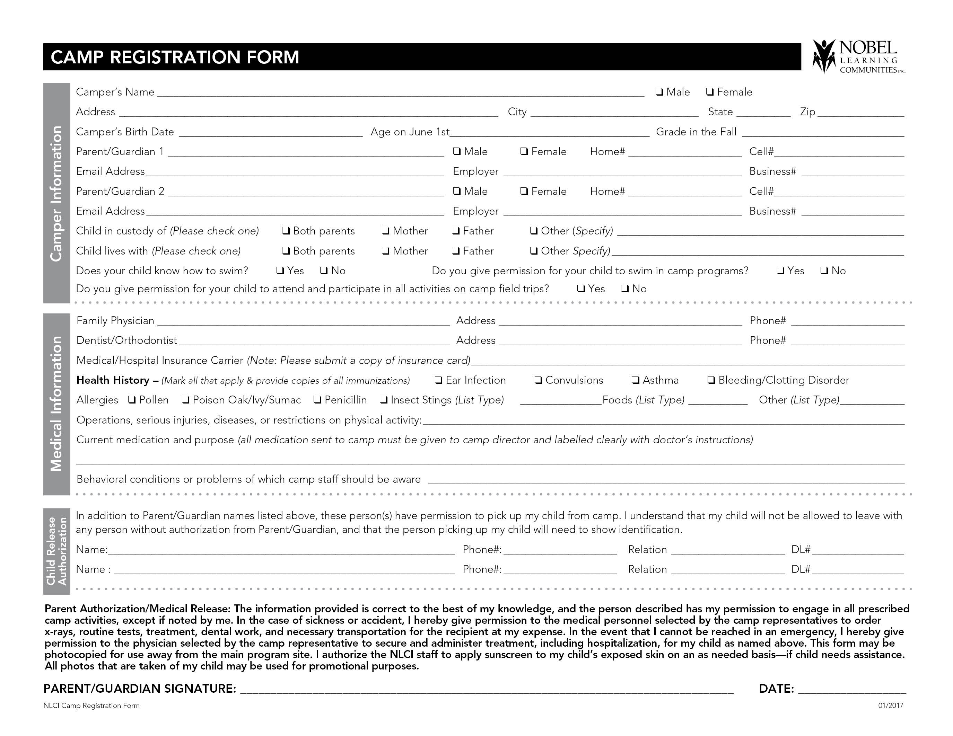
Merryhill Elementary Summerlin Summer Camp 2017

