Slide 1
Merryhill Preschool North Summerlin
2150 Snow Trail• Las Vegas, NV 89134 • 702-242-3230

Slide 2
Welcome!
As a continuation of our Links to Learning® curriculum, camp offers a fun-filled summer program for children ages 1 to 5. Each week, preschoolers jump into action, participating in fun and exciting activities and special events.
Our preschoolers have the opportunity to expand their horizons during the summer, embarking on new adventures, and having fun!
Although we want the children to have the best summer possible, we can’t forget about all they’ve learned during the school year.
Our Links to Learning summer curriculum is designed to review and strengthen skills taught during the school year. Various academic activities will be integrated throughout your child’s daily summer experience.
Our camp program will inspire your child’s mind to engage, explore, create and stay active this summer!
Summer Preschool Schedule
Week 1 June 1 – 5
Week 2 June 8 – 12
Week 3 June 15 – 19
Week 4 June 22 – 26
Week 5 June 29 – July 3
Week 6 July 6 – 10
Week 7 July 13 – 17
Week 8 July 20 – 24
Week 9 July 27 – 31
Merryhill Preschool North Summerlin– Preschool Summer Camp 2020

Slide 3
Activity Blocks
Sprinkled throughout each week, Activity Blocks give campers fun and variety in their camp day.
Art Buddies
Campers will put their creativity to the test as they use a hodgepodge of materials to create wacky and abstract masterpieces.
Major Leaguer
Campers will practice sportsmanship through sports and games that focus on sharing, taking turns and being a good friend.
Brain Games
Our little learners will join forces to solve puzzles and complete matching while developing problem-solving and reasoning skills.
Clay Play
We’ll be making quite the mess this summer as campers participate in hands-on, multi-sensory art projects using clay.
Shake it Out
Don’t just stand there… bust a move! Through dance, drama and music, campers will practice self-expression while tapping into their inner performer.
Eco-Explorers
Sunshine, water and nurturing is all it takes for a tiny seed to grow into a plant. Our campers will discover firsthand how weather and the environment affect living things.
Globetrotter
Buckle up! We’ll be going on a cultural adventure around the world to learn about different customs, traditions, and food.
S.T.E.A.M. Squad
Campers will discover a magical place where science, technology, engineering, art and math come together to ignite curiosity and problem-solving skills.
Safety Town
We’ll honor local police, firefighters, military and other community helpers, and show campers how they too can help by giving back and following safety rules.
Merryhill Preschool North Summerlin– Preschool Summer Camp 2020

Slide 4
Specialty Camps
*No Specialty camp will be offered during week 5.*
Ocean Explorers
Week 1
Baking 101
Week 6
Awesome Astronauts
Week 2
Science Lab
Week 7
Digging into Dinosaurs
Week 3
Going Green
Week 8
Little Chefs
Week 4
Garden Growers
Week 9
Merryhill Preschool North Summerlin– Preschool Summer Camp 2020

Slide 5
2020 Tuition & Fee Schedule
Select Camp Weeks
Tuition & Fees*
Week 1 June 1 – 5
Week 2 June 8 – 12
Week 3 June 15 – 19
Week 4 June 22 – 26
Week 5 June 29 – July 2 (Closed on the 3rd )
Week 6 July 6 – 10
Week 7 July 13 – 17
Week 8 July 20 – 24
Week 9 July 27 – 31
 | Weekly Amount | # of Weeks | # of Campers | Total Cost
Camp Tuition 5 HALF | $165
Camp Tuition 5 FULL | $190
Camp Tuition 5 EXT | $220
Specialty Camp add on | $54
One-Time Registration Fee |  |  |  | $90
Total
*Payment Policy: One week’s tuition is due at time of enrollment. We will apply the deposit to the final week of camp. Weekly camp fees are due every Monday morning at drop-off. We will charge a $25 late fee if payment is not received by 12 pm Tuesday.
Camper #1
Camper #2
Name: ______________________
Grade Completed: ____________
Date of Birth: _________________
Name: ______________________
Grade Completed: ____________
Date of Birth: _________________
Merryhill Preschool North Summerlin– Preschool Summer Camp 2020

Slide 6
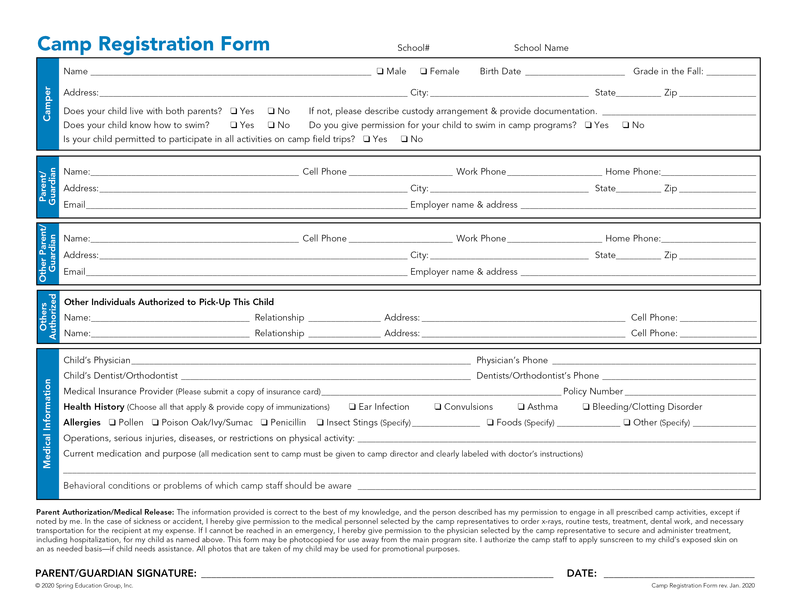
1321
Merryhill Preschool North Summerlin
Chesterbrook Academy West Chester – Preschool Summer Camp 2019

